Slide 1


BuildSafe IQ™
Transforming Construction Risk into Profit
John Smith, CEO
john.smith@buildsafeiq.com | (555) 123-4567
July 2025

Slide 2





What is BuildSafe IQ?
Predictive analytics platform that identifies construction risks 60 days before they impact your projects
Proactive intervention system that prevents costly delays, disputes, and budget overruns
Data-driven insights delivered by construction risk experts through quarterly business reviews
Profit enhancement tool that recovers 23% of potential profit lost to preventable construction risks
Confidential © 2025 BuildSafe IQ

Slide 3
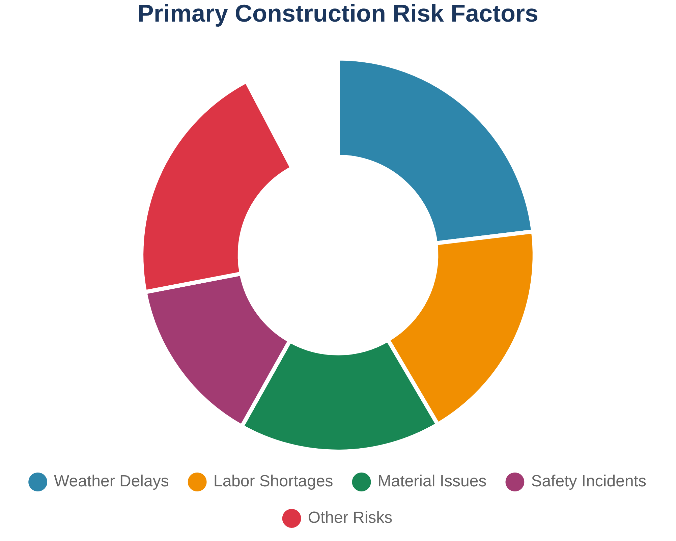
Construction projects face $2.5 trillion in annual risk exposure
The construction industry struggles with unpredictable risks that devastate project profitability and threaten business sustainability.
23%
36%
Average profit loss due to preventable construction risks
Projects experience significant delays impacting cash flow
$2.5T
78%
Annual global construction risk exposure requiring management
Contractors lack predictive risk management capabilities
Confidential © 2025 BuildSafe IQ

Slide 4
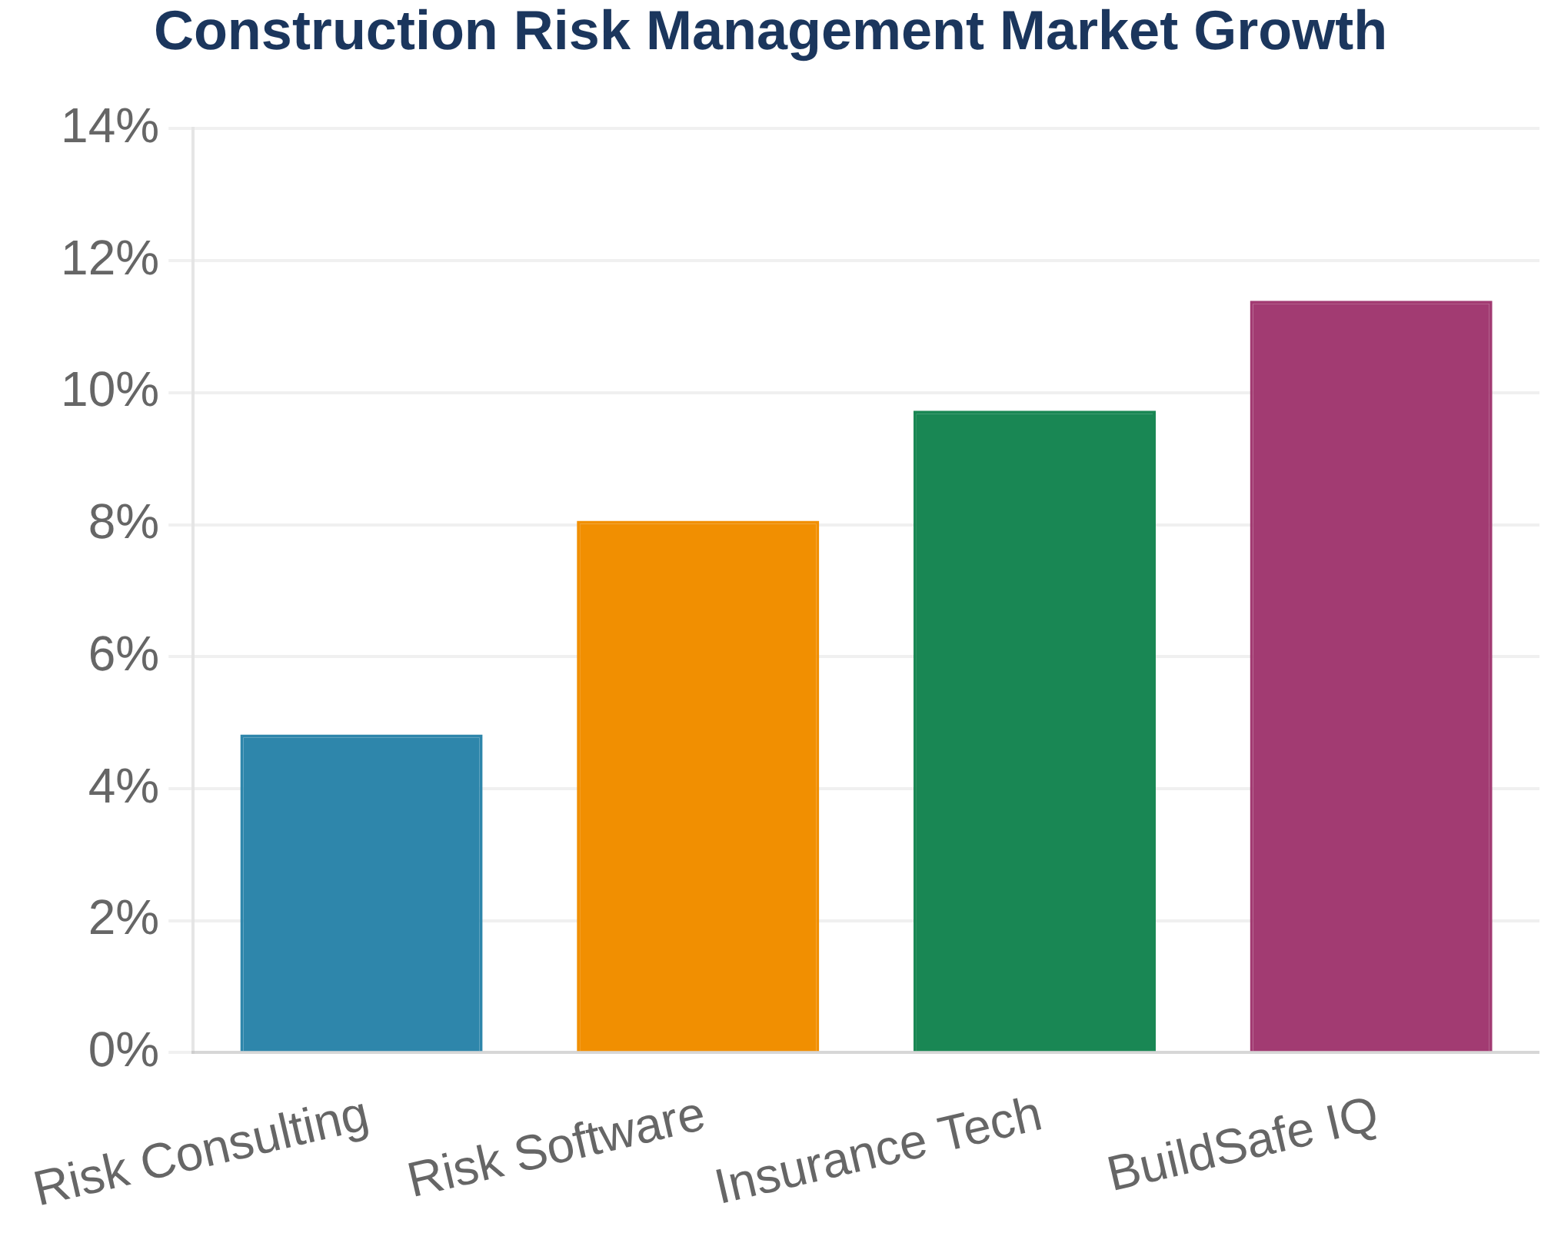
A $2.5 billion market opportunity in construction risk management
TAM
Total Addressable Market
$2.5B
SAM
Serviceable Available Market
$1.5B
SOM
Serviceable Obtainable Market
$500M
7,500+
23%
12.3%
Commercial contractors in target segment
Average profit loss due to preventable risks
Annual market growth rate
Confidential © 2025 BuildSafe IQ

Slide 5






RiskSync Framework™: Predictive risk management for construction excellence
BuildSafe IQ transforms construction risk management through our proprietary RiskSync Framework™, delivering predictive insights that prevent costly project disruptions.
Core Capabilities
Key Benefits
Predictive Risk Analytics
15-25% Profit Improvement
AI-powered algorithms predict potential project disruptions 30-90 days in advance
Prevent costly overruns through proactive risk management
30-90 Day Advance Warning
Real-time Risk Monitoring
Early detection provides time for effective mitigation
Continuous monitoring with instant alert notifications
8:1 ROI
Expert-Delivered Insights
Average return on investment within first year
Validated mitigation strategies with implementation timelines
Confidential © 2025 BuildSafe IQ

Slide 6




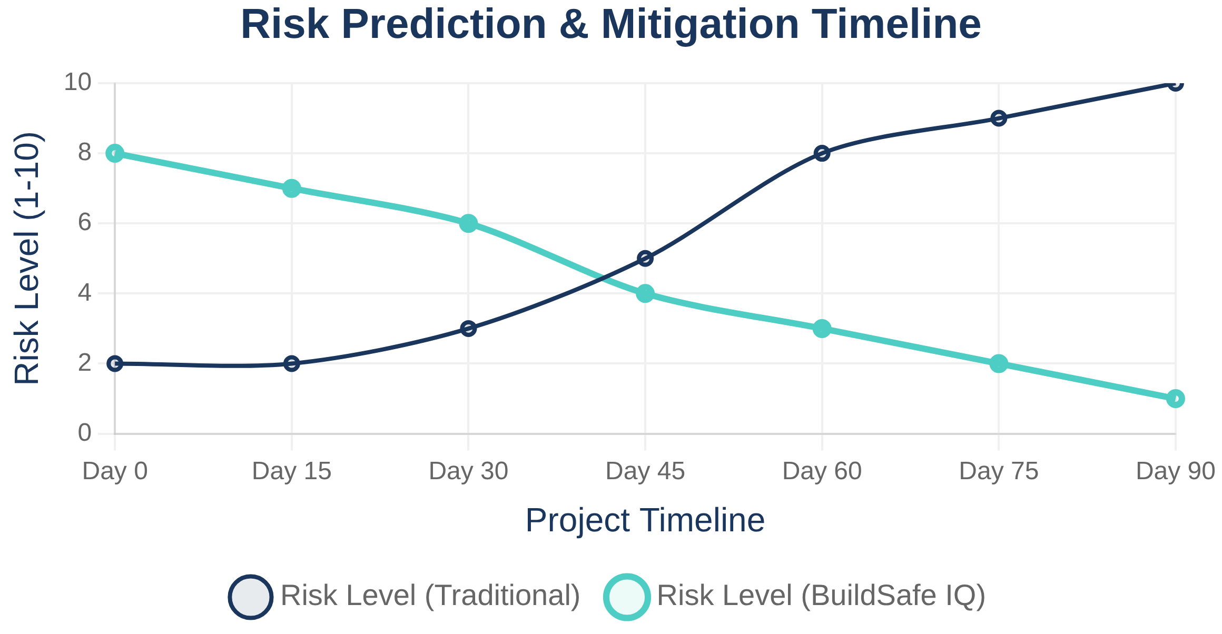









Data-driven risk prediction from 50+ construction indices
Weather & Climate Data
Labor Market Indices
Material Price Trends
Regulatory Changes
Economic Indicators
Supply Chain Data
Project Specifications
Historical Performance
Geographic Factors
Safety & Compliance
AI-Powered Prediction Engine
Machine learning algorithms analyze patterns across all data sources
Real-time processing with 60-day forward prediction capability
50+
60
87%
24/7
Risk scoring with confidence intervals and impact assessment
Data Sources
Days Early Warning
Prediction Accuracy
Monitoring
Continuous learning from project outcomes and feedback
Confidential © 2025 BuildSafe IQ

Slide 7


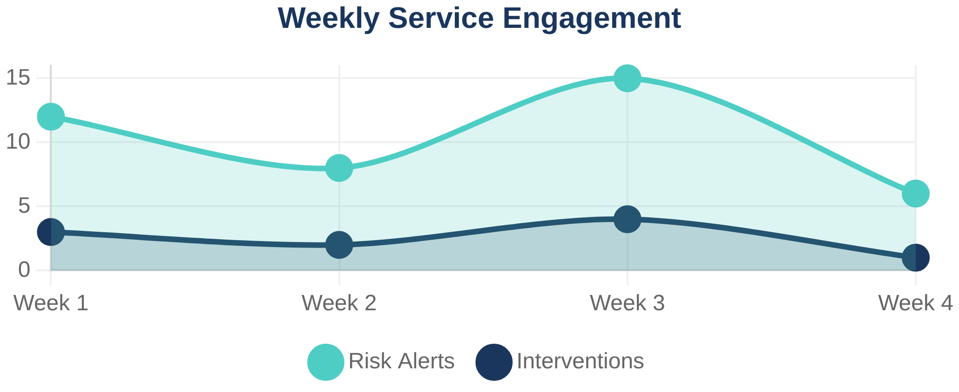


Fully integrated tech-enabled service team delivers continuous partnership
15-25%
30-90 Days
Continuous Partnership Model
Profit improvement through proactive risk management
Advance warning for critical risk factors
Our tech-enabled service team works as a fully integrated extension of your organization, providing continuous monitoring, proactive alerts, and expert guidance throughout every project lifecycle.
48+ Years
8:1 ROI
Combined construction expertise on our team
Average return on investment within first year
24/7 continuous monitoring with real-time risk alerts
Weekly check-ins and monthly deep-dive sessions
Quarterly business reviews with strategic planning
Fully integrated partnership with your teams
Confidential © 2025 BuildSafe IQ

Slide 8








BuildSafe IQ delivers comprehensive risk coverage across all categories
Comprehensive Coverage
Provider
Safety Risk
Financial Risk
Compliance Risk
Integrated Risk View
Only solution covering safety, financial, compliance, and integrated risk management
Predictive Analytics
BuildSafe IQ
✓
✓
✓
✓
AI-powered risk prediction 30-90 days in advance vs. reactive monitoring
Procore Risk Modules
⚠
✓
✗
✗
Expert-Delivered Service
48+ years construction experience backing technology with human expertise
Origami Risk / Riskconnect
✗
✓
✓
✗
✗
✗
✓
✗
Quantified Impact
Billy Compliance
Precise financial modeling of risk impact on project profitability
MyCOI
✗
✗
✓
✗
Continuous Partnership
Lockton (Broker Services)
⚠
✓
✓
✗
24/7 monitoring with weekly check-ins vs. quarterly or annual reviews
Alliant (Broker Services)
⚠
✓
✓
✗
Seamless Integration
✓
✗
✗
✗
Works with existing systems without requiring platform migration
Smartvid.io / Newmetrix
Proven ROI
8:1 return on investment with 15-25% profit improvement
Confidential © 2025 BuildSafe IQ

Slide 9
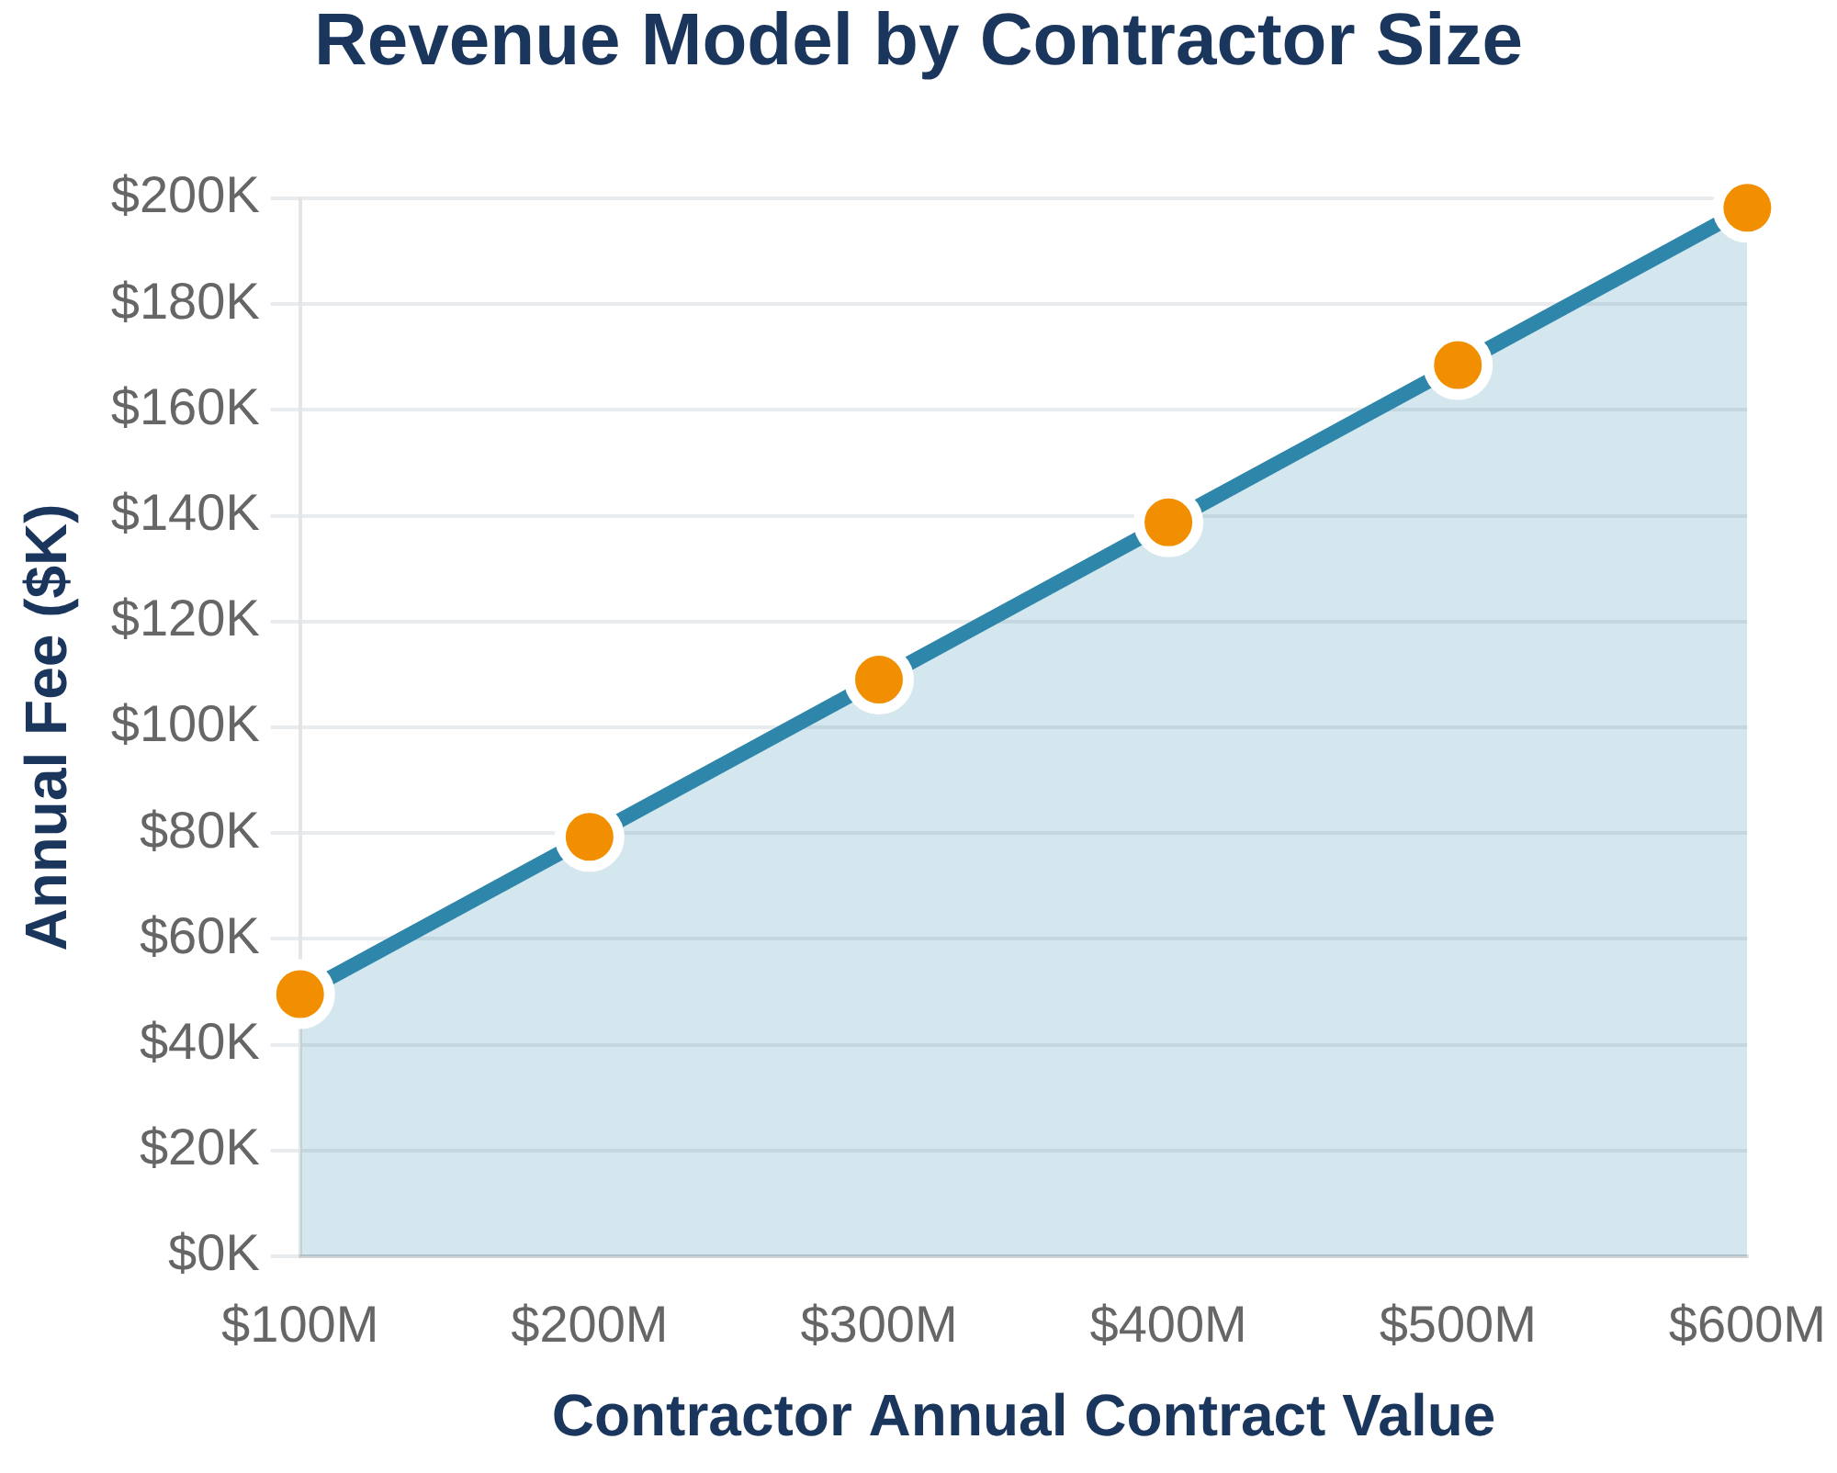
Cash positive with just 19 clients, with 2.5x margin expansion through insurance brokerage
BuildSafe IQ operates as a tech-enabled service provider with annual fees based on contractor revenue, achieving cash positivity with minimal client base.
ACV
ACV
ACV
$100M
$300M
$600M
$50K
$110K
$200K
19
2.5x
Clients needed for cash positive
Margin expansion through insurance brokerage
Confidential © 2025 BuildSafe IQ
$1.4M
7,500+
Revenue at cash positive threshold
Target contractors in addressable market

Slide 10



















Strategic Exit Opportunities
Construction Technology
Risk Management & Insurance
Data & Analytics
Enterprise Software
Financial Services
JPMorgan Chase
Goldman Sachs
BlackRock
Fidelity
BuildSafe IQ™ - Confidential and Proprietary

Slide 11


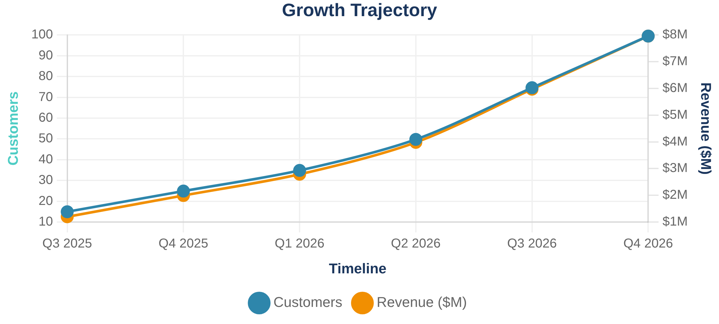



18-month roadmap with key development and market milestones
BuildSafe IQ has a clear 18-month roadmap for product development, market expansion, and funding milestones to achieve Series A readiness.
Product Development
Q3 2025 - Q1 2026
Customer Acquisition
Q3 2025 - Q4 2026
Q3 2025: MVP Launch
First 15 beta customers with core risk prediction functionality and QBR model
Market Expansion
Q1 2026 - Q4 2026
Series A Preparation
Q2 2026 - Q4 2026
Q4 2025: Platform Enhancement
Advanced analytics, expanded data sources, and automated reporting capabilities
Q2 2026: 50 Customer Milestone
Expansion into 5 major metropolitan markets with proven scalability
Q4 2026: Series A Ready
$5M+ ARR, 95%+ retention, and proven unit economics for growth funding
Key Metrics Target
Cash positive with 19 clients, 2.5x margin expansion through insurance brokerage
Confidential © 2025 BuildSafe IQ

Slide 12

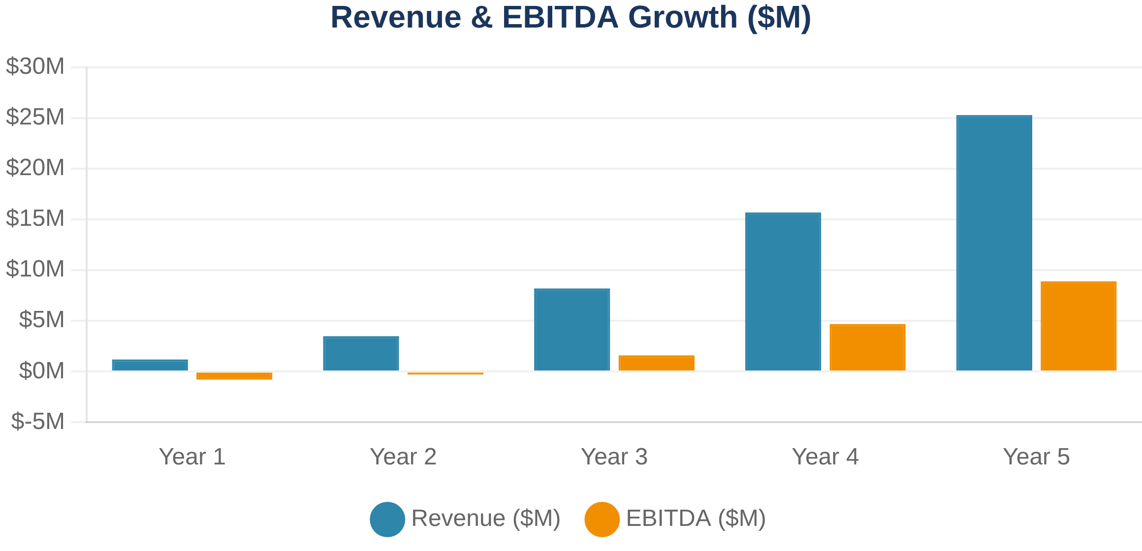
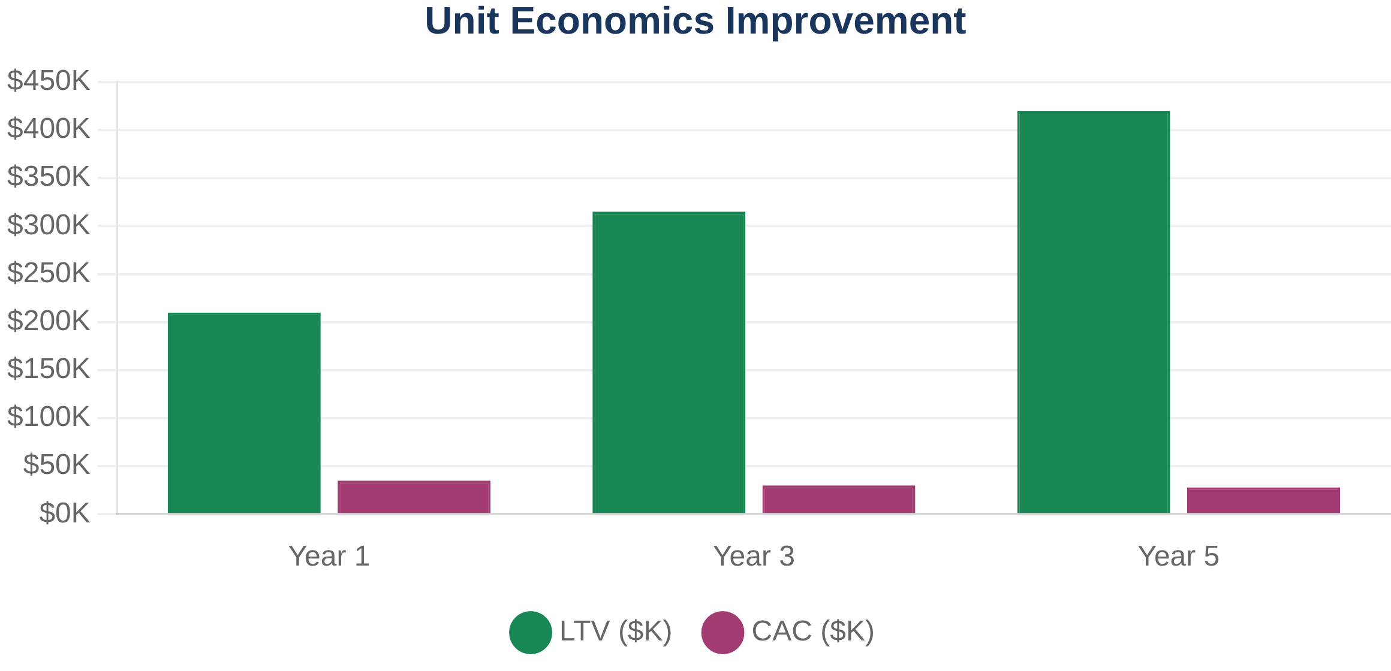
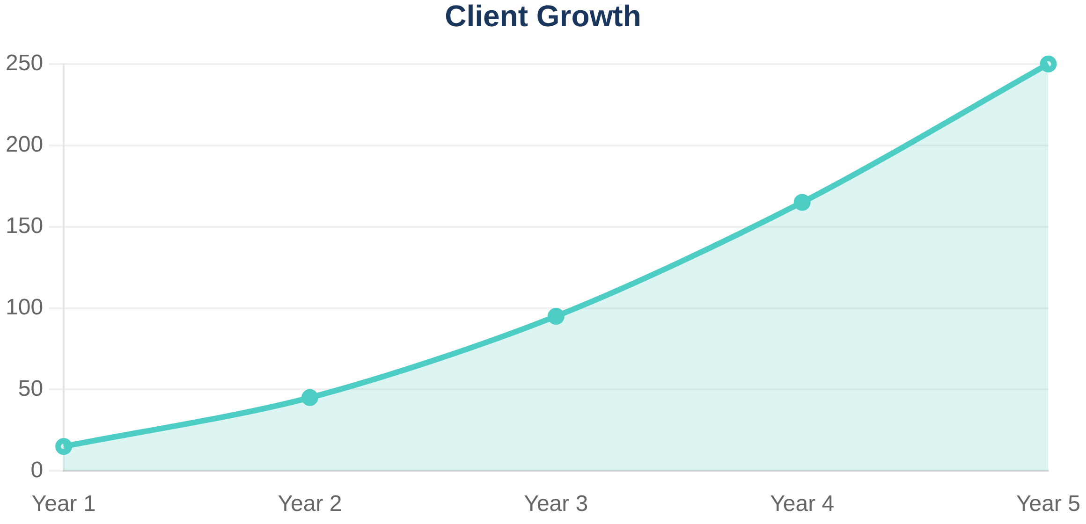
5-year financial projections with path to profitability
CAC
LTV
LTV:CAC
$35K
$210K
6:1
Year 1 → $28K Year 5
Year 1 → $420K Year 5
Year 1 → 15:1 Year 5
Key Financial Assumptions
•
Client Acquisition:
15 clients (Year 1) → 250+ clients (Year 5)
•
Revenue Growth:
$1.2M (Year 1) → $25M+ (Year 5)
•
Retention Rate:
85% (Year 1) → 92% (Year 5)
•
Expansion Revenue:
15% (Year 2) → 35% (Year 5)
CAGR (5-Year)
Gross Margin
EBITDA Positive
•
Gross Margin:
65% (Year 1) → 78% (Year 5)
115%
78%
Year 3
Revenue Growth
Year 5
Q2
Confidential © 2025 BuildSafe IQ

Slide 13

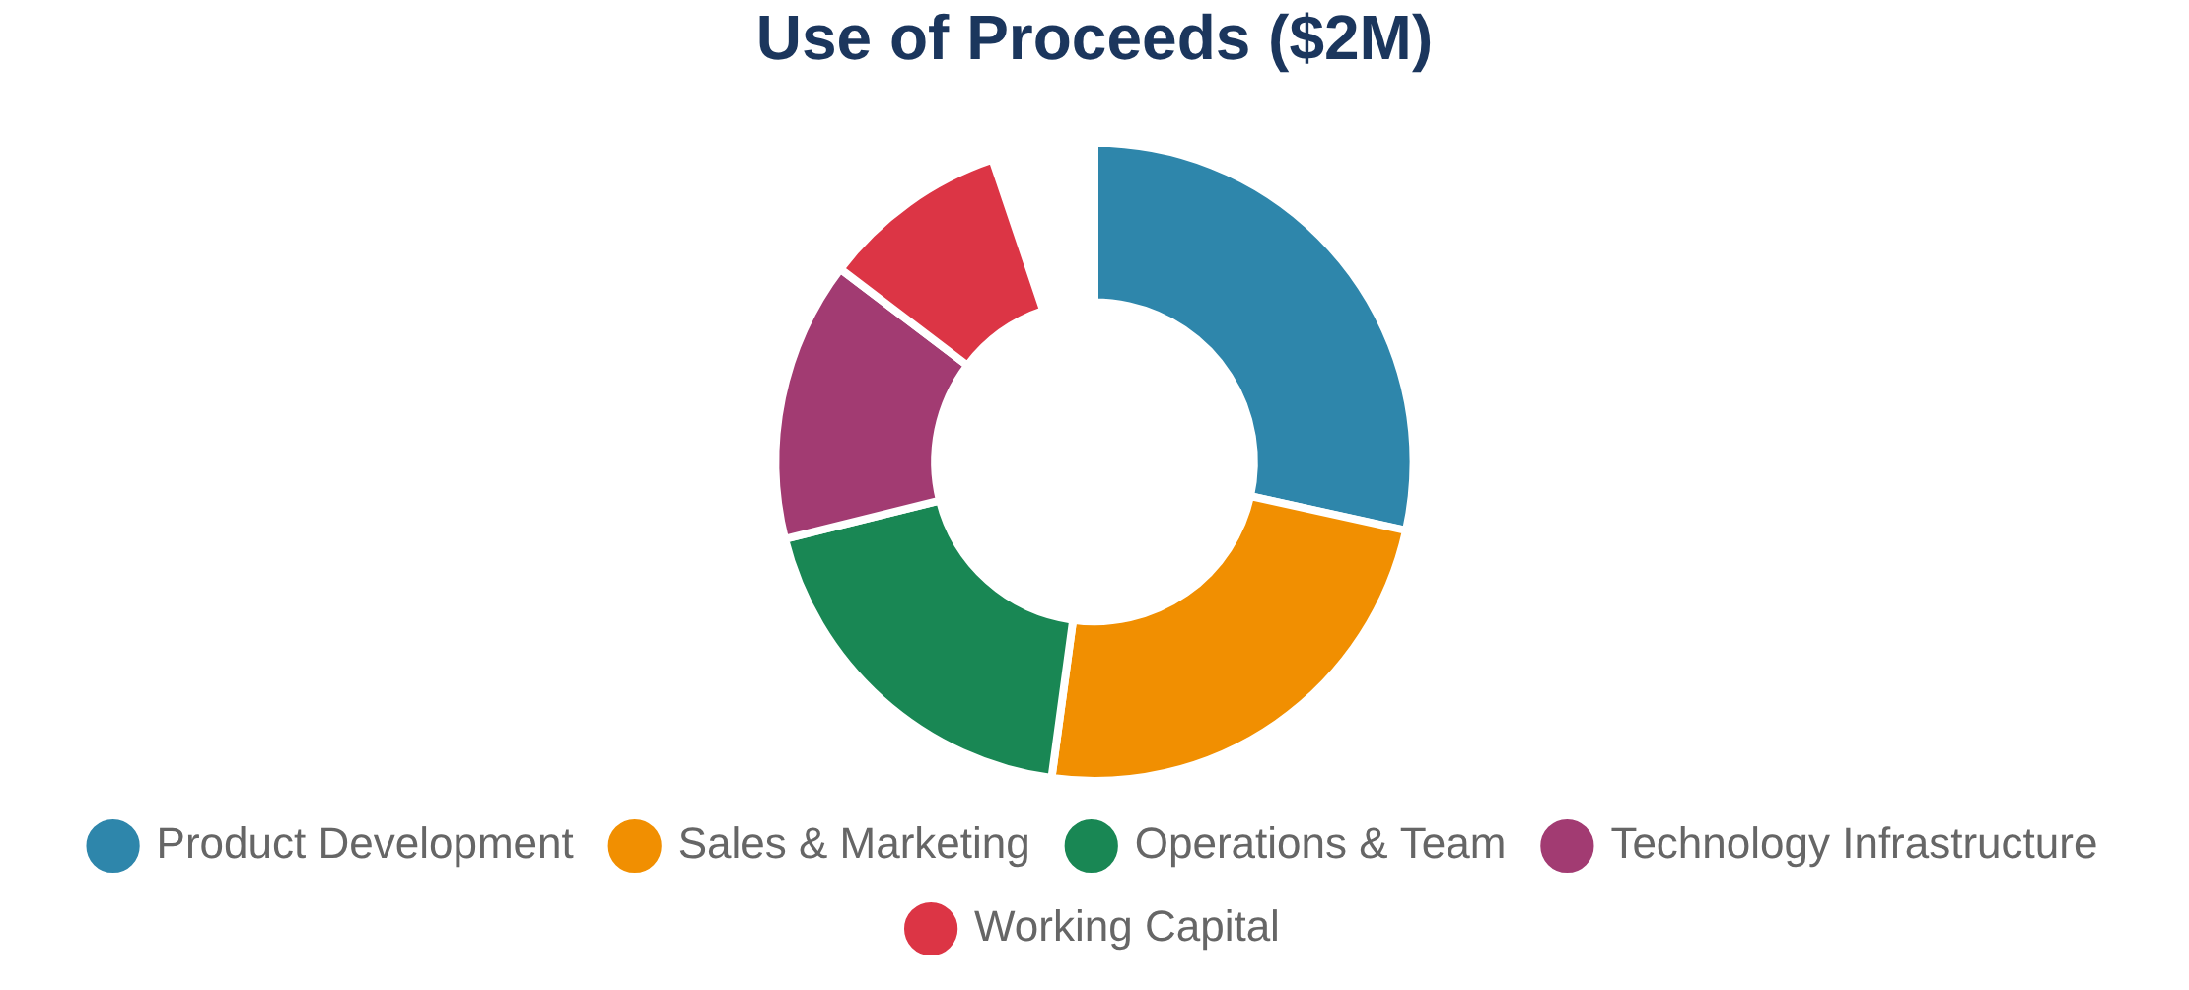









$2M funding to accelerate growth and achieve Series A readiness
Strategic deployment of $2M funding to scale operations, enhance technology platform, and establish market leadership position for Series A fundraising in 18 months.
Strategic Exit Opportunities
Construction Technology
Risk Management & Insurance
Data & Analytics
Category
Amount
%
Product Development
$600K
30%
Sales & Marketing
$500K
25%
Operations & Team
$400K
20%
Technology Infrastructure
$300K
15%
Working Capital
$200K
10%
BuildSafe IQ™ - Confidential and Proprietary

Slide 14







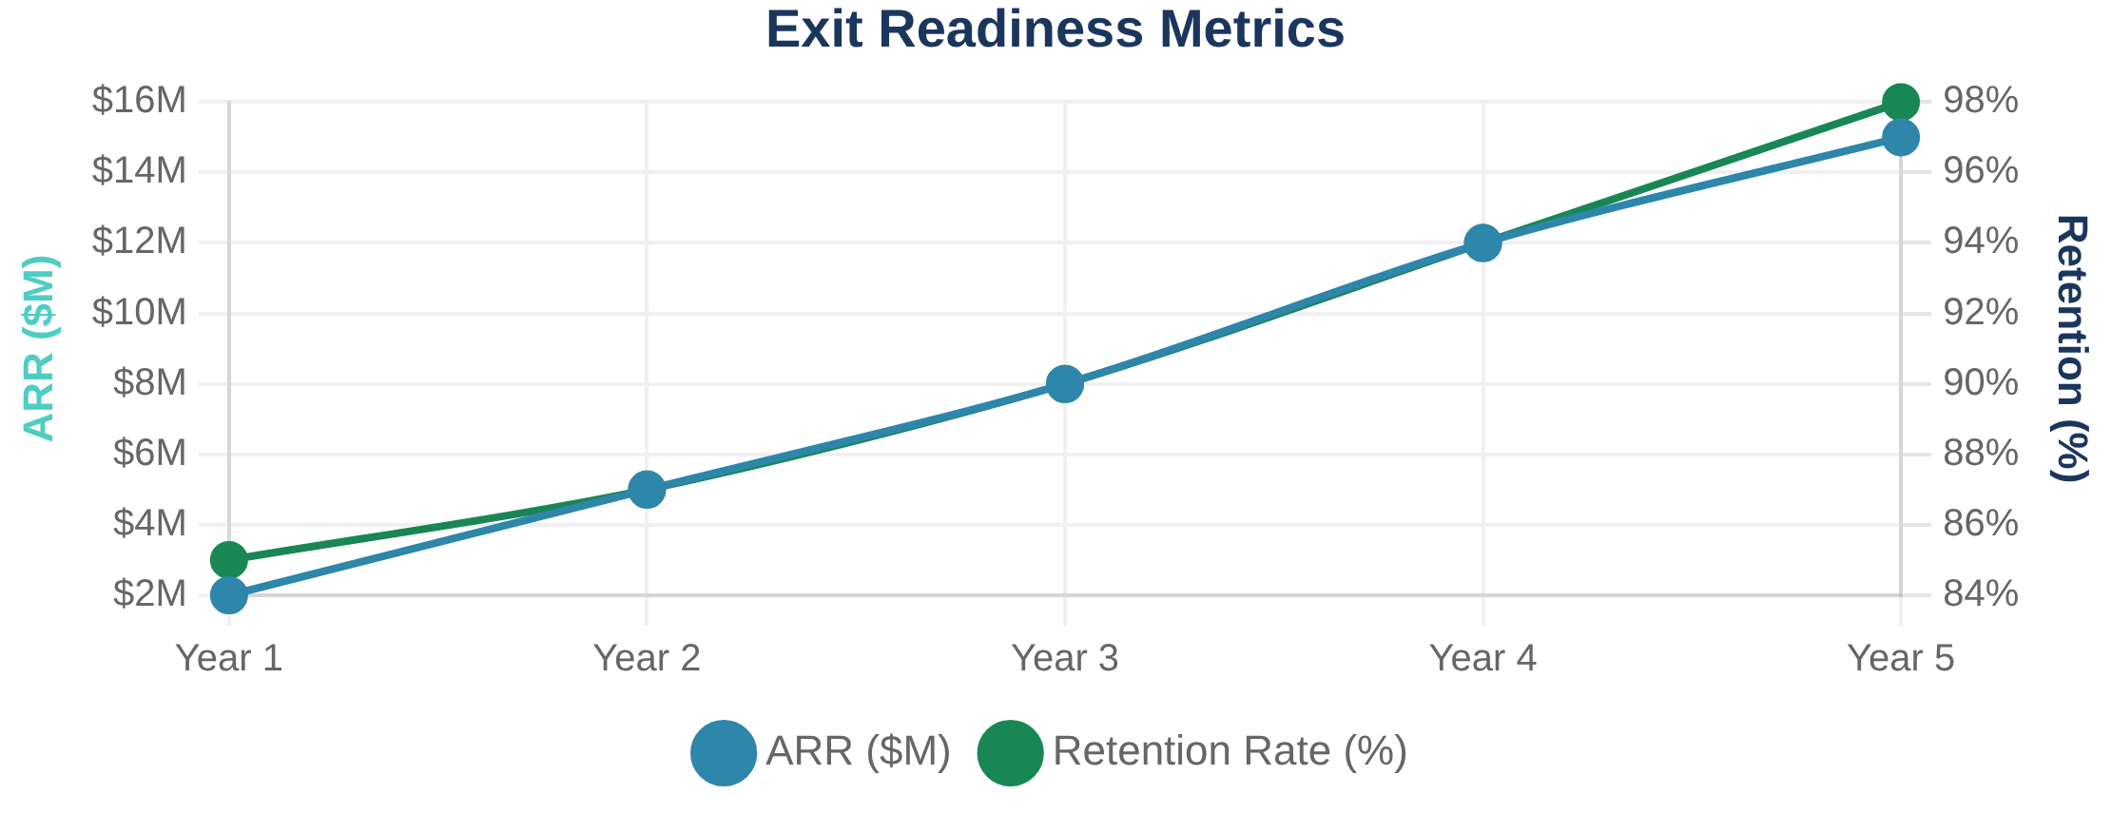

Clear path to strategic exit with multiple acquisition opportunities
BuildSafe IQ is positioned for strategic acquisition by construction technology leaders, insurance companies, or data analytics firms seeking to expand their risk management capabilities.
90%
Current retention rate target for Year 3
Exit Timeline & Milestones
98%
Year 1-2: Foundation
Retention rate target by Year 5
Establish market presence, achieve 50+ customers, prove unit economics
Year 3: Growth
$15M+
Scale to 100+ customers, $8M+ ARR, 90% retention rate
ARR target at exit readiness
Year 4-5: Exit Ready
200+
Market leadership position, 98% retention, strategic acquisition
Customer base at strategic exit
5-8x
Expected revenue multiple at exit
Strategic Value Drivers
• Proprietary RiskSync Framework™ with AI/ML capabilities
• Deep construction industry relationships and expertise
• Proven customer retention and expansion metrics
• Scalable technology platform with integration capabilities
• Clear path to insurance brokerage revenue expansion
Confidential © 2025 BuildSafe IQ

Slide 15




Ready to transform construction risk management together
Next Steps
Contact Information
1
Initial Discussion
Aaron Lavespere, CEO & Co-Founder
Schedule a 30-minute call to discuss investment opportunity and answer questions
aaron@buildsafeiq.com
(555) 123-4567
www.buildsafeiq.com
2
Due Diligence
Review detailed financials, customer references, and technical documentation
Schedule a Meeting
3
Product Demo
Experience RiskSync Framework™ with live customer data and use cases
4
Investment Decision
Finalize terms and join BuildSafe IQ's growth journey
Confidential © 2025 BuildSafe IQ
Investment Highlights
• $2M funding for 18-month growth acceleration
• Clear path to Series A with proven unit economics
• Experienced team with 100+ years combined experience
• Multiple strategic exit opportunities identified
• First-mover advantage in construction risk analytics

Slide 16
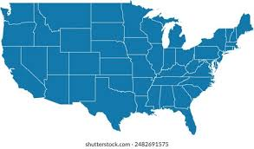
Target Markets & Commercial Contractor Landscape
Target Market Analysis
Florida
8,500+
Texas
12,200+
S.California
6,800+
Metro DC
3,200+
Metro NY
4,800+
35,500+
Total Commercial General Contractors
in Target Markets
Confidential © 2025 BuildSafe IQ

